Slide 1
LAND ASSET CADENCE MEETING RUMUAHIA PU STOG DEEP DIVE

Slide 2
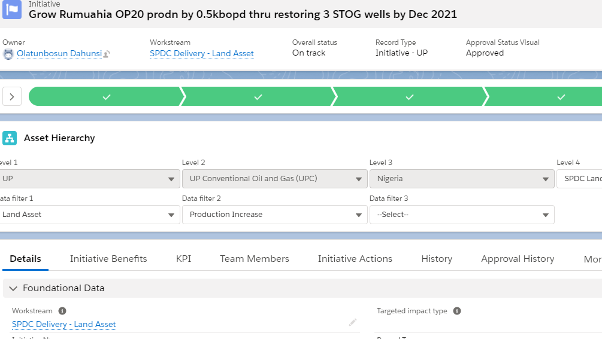
RUMUAHIA - I-0122757 Grow Rumuahia OP20 prodn by 0.5kbopd thru restoration of 3 STOG wells by Dec 2021
Promise LW
C&P to send ITT to contractors and schedule online bidding
Achieved LW
Promise TW

Slide 3
2021 STOG CANDIDATES
RUMUAHIA - I-0122757 Grow Rumuahia OP20 prodn by 0.5kbopd thru restoration of 3 STOG wells by Dec 2021
SUPPORT REQUIRED
CWI TO FSTRACK AHIA CANDIDATES

